Slide 1
Chebychev's Inequality

Slide 2
Chebychev's Inequality
A probability theory that guarantees only a definite fraction of values will be found within a specific distance from the mean of a distribution
Chebyshev's inequality is a probabilistic inequality. It provides an upper bound to the probability that the absolute deviation of a random variable from its mean will exceed a given threshold
Chebyshev’s inequality is a probability theory that guarantees that within a specified range or distance from the mean, for a large range of probability distributions, no more than a specific fraction of values will be present. In other words, only a definite fraction of values will be found within a specific distance from the mean of a distribution

Slide 3
Chebyshev’s Inequality History
Chebyshev’s inequality was proven by Pafnuty Chebyshev, a Russian mathematician, in 1867.
It was stated earlier by French statistician Irénée-Jules Bienaymé in 1853; however, there was no proof for the theory made with the statement.
After Pafnuty Chebyshev proved Chebyshev’s inequality, one of his students, Andrey Markov, provided another proof for the theory in 1884
Chebyshev's inequality has many applications, but the most important one is probably the proof of a fundamental result in statistics, the so-called Chebyshev's Weak Law of Large Numbers.

Slide 4

Statement
Let X be a random variable with a finite mean denoted as µ and a finite non-zero variance, which is denoted as σ2, for any real number, K>0. Then, the following inequality, called Chebyshev's inequality, holds:

Slide 5
Example-1
Assume that an asset is picked from a population of assets at random. The average return of the population of assets is 12%, and the standard deviation of the population of assets is 5%. To calculate the probability that an asset picked at random from this population, which has a return less than 4% or greater than 20%, Chebyshev’s inequality can be applied.
Since there is a limited amount of information and only the mean and standard deviation of a distribution is given, the exact probability of this scenario cannot be determined; thus, Chebyshev’s inequality is applied. Below is the application of the theory:

Slide 6
Example-1
|X – µ| ≥ K
P(|X – µ|≥K) ≤ (σ²/ K²) = (5%²/8%²)
P(|X – µ|≥K) ≤ (σ²/ K²) = 39.06%
Where:
Standard deviation: 5%
Mean: 12%
K: 8%
Thus, the probability of an asset’s return to be less than 4% or greater than 20% from the population of assets, which has a mean return of 12% with a standard deviation of 5%, is less than 39.06%, according to Chebyshev’s inequality.

Slide 7
Example-2
Suppose that we extract an individual at random from a population whose members have an average income of $40,000, with a standard deviation of $20,000.
What is the probability of extracting an individual whose income is either less than $10,000 or greater than $70,000?
In the absence of more information about the distribution of income, we cannot compute this probability exactly. However, we can use Chebyshev's inequality to compute an upper bound to it.

Slide 8
Example-2
Suppose that we extract an individual at random from a population whose members have an average income of $40,000, with a standard deviation of $20,000.
What is the probability of extracting an individual whose income is either less than $10,000 or greater than $70,000?
In the absence of more information about the distribution of income, we cannot compute this probability exactly. However, we can use Chebyshev's inequality to compute an upper bound to it.

Slide 9
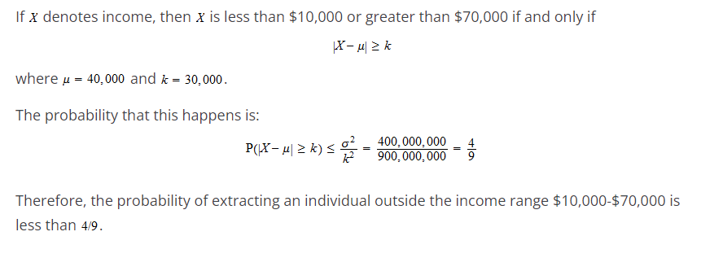
Example-2

